Slide 1
Service Overview Business Entity

Slide 2
Service Domain
SID model enables a seamless transition from business concepts and definitions to other domains, such as networking.
Product (Offering) is an externally facing representation of a Service and/or Resource procured by the market; for example, a real-time broadcast of a football match. In this example, the Customer buys the Product, which may require dedicated hardware to run the Services that make up the Product. In this view, a Service is an intangible realization of a Product or something provided in support of a Product; for example, a video streaming connection used to transmit the footbal match to a customer’s PDA, an installation service provided for a cable modem, or specific Quality of Service (QoS) settings that are required to provide an acceptable end-user experience watching the football match. A Resource is part of an enterprise’s infrastructure utilized by a Service or a good procured by the market in the form of a Product. In the above example, a wireless network utilized by a video streaming connection is an example of a Resource

Slide 3
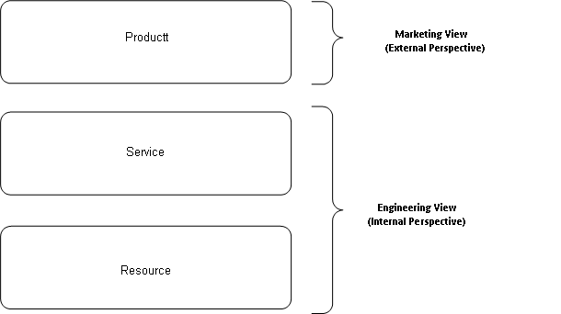
Product and Service

Slide 4
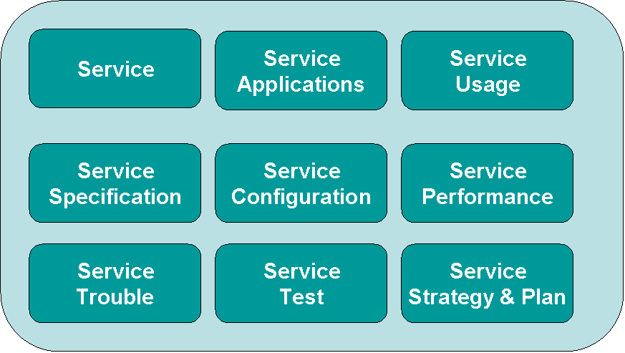
Level One of the Service Domain of the SID Framework

Slide 6
Service
Service that is part of a Product, that is obtained by a Customer – we’ll call this a CustomerFacingService
A Service that is indirectly part of a Product, but is invisible to the Customer – it exists to support one or more CustomerFacingServices. We’ll call this a ResourceFacingService

Slide 7
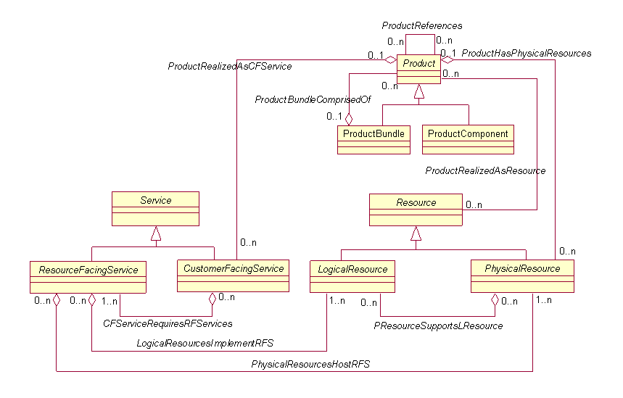

Slide 8
Resources
PhysicalResources, such as a Customer’s router, can be tied to a Product through the ProductHasPhysicalResources aggregation
LogicalResources, such as the programming of a particular device interface, are represented as ResourceFacingServices; hence, the LogicalResourcesImplementRFS aggregation relates these LogicalResources to a ResourceFacingService
Abstract items like “GoldService” are CustomerFacingServices and are represented using the ProductHasCustomerFacingServices aggregation (later, we’ll see that this is represented as a type of CustomerFacingServiceSpecification, called a ServicePackage)
GoldService is supported by particular types of ResourceFacingServices through the CFServiceRequiresRFServices aggregation (it is an aggregation because it may take several ResourceFacingServices to build a single CustomerFacingService; later, we’ll see that this is represented as a type of ResourceFacingServiceSpecification, called a ServiceBundle).

